Slide 1
Error Control
Digital transmission systems introduce errors
Applications require certain reliability level
  Data applications require error-free transfer
  Voice & video applications tolerate some errors
Error control used when transmission system does not meet application requirement
Error control ensures a data stream is transmitted to a certain level of accuracy despite errors
Two basic approaches:
  Error detection & retransmission (ARQ)
  Forward error correction (FEC)

Slide 2
Error Control
Error control is handling network errors caused by problems in transmission, not human errors.
Error types include corrupted data and lost data.
Error control is concerned with:
1) preventing, 2) detecting and 3) correcting errors.
While errors can occur in a single bit, they can also be longer.
An important error type is a burst error in which many bits are corrupted at the same time.

Slide 3
Sources of Errors (Figure 4-2)
Sources of errors include:
  Line outages in which a circuit fails
  White noise caused by thermal energy (hiss)
  Impulse noise (spikes) are an important source of burst errors and can be caused by lightning, power surges, and poor connections
  Cross-talk occurs when one circuit picks up signals from another
  Echoes are caused by poor connections causing the signal to be reflected back to the transmitting source
  Attenuation is the weakening of a signal over a distance
  Jitter occurs due to small variations in the amplitude, frequency, and phase of a signal
  Harmonic distortion occurs when an amplifier does not correctly amplify its input signal

Slide 4

Sources of Errors

Slide 5
Source of Error
What causes it
How to prevent it
Line Outages
Storms, accidents
White Noise
Movement of electrons
Increase signal strength
Impulse Noise
Sudden increases in electricity
(e.g., lightning)
Shield or move the wires
Cross-talk
Multiplexer guard bands are too small or wires too close together
Increase the guard bands, or
move or shield the wires
Echo
Poor connections
Fix the connections, or
tune equipment
Attenuation
Gradual decrease in signal over distance
Use repeaters or amplifiers
Intermodulation Noise
Signals from several circuits combine (form of crosstalk)
Move or shield the wires
Jitter
Analog signals change phase
Tune equipment
Harmonic Distortion
Amplifier changes phase
Tune equipment
Figure 4-2 Sources of errors and ways to prevent or minimize them

Slide 6
Key Idea
All transmitted data blocks (“codewords”) satisfy a pattern
If received block doesn’t satisfy pattern, it is in error
Redundancy: only a subset of all possible blocks can be codewords
Blindspot: when channel transforms a codeword into another codeword
All inputs to channel
satisfy pattern or condition
Channel
output
Deliver user
information or
set error alarm
User
information
Encoder
Channel
Pattern
checking

Slide 7
Single Parity Check
Append an overall parity check to k information bits
Info Bits: b₁, b₂, b₃, …, b_{k}
Check Bit: b_{k+1}= b₁+ b₂+ b₃+ …+ b_{k} modulo 2
Codeword: (b₁, b₂, b₃, …, b_{k,}, b_{k+!})
All codewords have even # of 1s
Receiver checks to see if # of 1s is even
  All error patterns that change an odd # of bits are detectable
  All even-numbered patterns are undetectable
Parity bit used in ASCII code

Slide 8
Example of Single Parity Code
Information (7 bits): (0, 1, 0, 1, 1, 0, 0)
Parity Bit: b₈ = 0 + 1 +0 + 1 +1 + 0 = 1
Codeword (8 bits): (0, 1, 0, 1, 1, 0, 0, 1)
If single error in bit 3 : (0, 1, 1, 1, 1, 0, 0, 1)
  # of 1’s =5, odd
  Error detected
If errors in bits 3 and 5: (0, 1, 1, 1, 0, 0, 0, 1)
  # of 1’s =4, even
  Error not detected

Slide 9
Check bits & Error Detection
Information bits
Received information bits
Recalculate check bits
k bits
Channel
Calculate check bits
Compare
Sent check
bits
Received check bits
Information accepted if check bits match
n – k bits

Slide 10
How good is the single parity check code?
Redundancy: Single parity check code adds 1 redundant bit per k information bits: overhead = 1/(k + 1)
Coverage: all error patterns with odd # of errors can be detected
  An error pattern is a binary (k + 1)-tuple with 1s where errors occur and 0’s elsewhere
  Of 2^{k+1} binary (k + 1)-tuples, ½ are odd, so 50% of error patterns can be detected
Is it possible to detect more errors if we add more check bits?
Yes, with the right codes

Slide 11
What if bit errors are random?
Many transmission channels introduce bit errors at random, independently of each other, and with probability p
Some error patterns are more probable than others:
p
1 – p
P[10000000] = p(1 – p)⁷ = (1 – p)⁸ and
P[11000000] = p²(1 – p)⁶ = (1 – p)⁸
p ²
1 – p
In any worthwhile channel p < 0.5, and so (p/(1 – p) < 1
It follows that patterns with 1 error are more likely than patterns with 2 errors and so forth
What is the probability that an undetectable error pattern occurs?

Slide 12
Single parity check code with random bit errors
Undetectable error pattern if even # of bit errors:
P[error detection failure] = P[undetectable error pattern]
= P[error patterns with even number of 1s]
= p²(1 – p)^{n-2} + p⁴(1 – p)^{n-4} + …
n
2
n
4
Example: Evaluate above for n = 32, p = 10⁻³
32
2
32
4
P[undetectable error] = (10⁻³)² (1 – 10⁻³)³⁰ + (10⁻³)⁴ (1 – 10⁻³)²⁸
≈ 496 (10⁻⁶) + 35960 (10⁻¹²) ≈ 4.96 (10⁻⁴)
For this example, roughly 1 in 2000 error patterns is undetectable

Slide 13
What is a good code?
Many channels have preference for error patterns that have fewer # of errors
These error patterns map transmitted codeword to nearby n-tuple
If codewords close to each other then detection failures will occur
Good codes should maximize separation between codewords
o
o
o
x
o
x
Poor
distance properties
x
x
x
o
o
o
x
x
o
o
o
o
o
x = codewords
o = noncodewords
o
x
o
x
o
o
o
Good
distance properties
x
o
x
o
x
o
o
o
x
o
x
o

Slide 14
Two-Dimensional Parity Check
More parity bits to improve coverage
Arrange information as columns
Add single parity bit to each column
Add a final “parity” column
Used in early error control systems
1 0 0 1 0 0
0 1 0 0 0 1
1 0 0 1 0 0
1 1 0 1 1 0
1 0 0 1 1 1
Last column consists of check bits for each row
Bottom row consists of check bit for each column

Slide 15
Error-detecting capability
1 0 0 1 0 0
0 0 0 0 0 1
1 0 0 1 0 0
1 1 0 1 1 0
1 0 0 1 1 1
1 0 0 1 0 0
0 0 0 0 0 1
1 0 0 1 0 0
1 0 0 1 1 0
1 0 0 1 1 1
One error
Two errors
1, 2, or 3 errors can always be detected; Not all patterns >4 errors can be detected
1 0 0 1 0 0
0 0 0 1 0 1
1 0 0 1 0 0
1 0 0 1 1 0
1 0 0 1 1 1
1 0 0 1 0 0
0 0 0 1 0 1
1 0 0 1 0 0
1 0 0 0 1 0
1 0 0 1 1 1
Three errors
Four errors (undetectable)
Arrows indicate failed check bits

Slide 16
Other Error Detection Codes
Many applications require very low error rate
Need codes that detect the vast majority of errors
Single parity check codes do not detect enough errors
Two-dimensional codes require too many check bits
The following error detecting codes used in practice:
  Internet Check Sums
  CRC Polynomial Codes

Slide 17
Internet Checksum
Several Internet protocols (e.g., IP, TCP, UDP) use check bits to detect errors in the IP header (or in the header and data for TCP/UDP)
A checksum is calculated for header contents and included in a special field.
Checksum recalculated at every router, so algorithm selected for ease of implementation in software
Let header consist of L, 16-bit words,
  b₀, b₁, b₂, ..., b_{L-1}
The algorithm appends a 16-bit checksum b_{L}

Slide 18
Checksum Calculation
The checksum b_{L} is calculated as follows:
Treating each 16-bit word as an integer, find
x = b₀ + b₁ + b₂+ ...+ b_{L-1} modulo 2¹⁶-1
The checksum is then given by:
b_{L} = - x modulo 2¹⁶-1
Thus, the headers must satisfy the following pattern:
0 = b₀ + b₁ + b₂+ ...+ b_{L-1} + b_{L} modulo 2¹⁶-1
The checksum calculation is carried out in software using one’s complement arithmetic

Slide 19
Internet Checksum Example
Use Modulo Arithmetic
Assume 4-bit words
Use mod 2⁴-1 arithmetic
b₀=1100 = 12
b₁=1010 = 10
b₀+b₁=12+10=7 mod15
b₂ = -7 = 8 mod15
Therefore
b₂=1000
Use Binary Arithmetic
Note 16 =1 mod15
So: 10000 = 0001 mod15
leading bit wraps around
b₀ + b₁ = 1100+1010
=10110
=10000+0110
=0001+0110
=0111
=7
Take 1s complement
b₂ = -0111 =1000

Slide 20
Polynomial Codes
Polynomials instead of vectors for codewords
Polynomial arithmetic instead of check sums
Implemented using shift-register circuits
Also called cyclic redundancy check (CRC) codes
Most data communications standards use polynomial codes for error detection
Polynomial codes is the basis for powerful error-correction methods

Slide 21
Binary Polynomial Arithmetic
Binary vectors map to polynomials
(i_{k-1} , i_{k-2} ,…, i₂ , i₁ , i₀) → i_{k-1}x^{k-1} + i_{k-2}x^{k-2} + … + i₂x² + i₁x + i₀
Addition:
(x⁷ + x⁶ + 1) + (x⁶ + x⁵) = x⁷ + x⁶ + x⁶ + x⁵ + 1
= x⁷ +(1+1)x⁶ + x⁵ + 1
= x⁷ +x⁵ + 1 since 1+1=0 mod2
Multiplication:
(x + 1) (x² + x + 1) = x(x² + x + 1) + 1(x² + x + 1)
= x³ + x² + x + (x² + x + 1)
= x³ + 1

Slide 22
Binary Polynomial Division
Division with Decimal Numbers
4
3
quotient
dividend = quotient x divisor +remainder
35 ) 1222
dividend
105
1222 = 34 x 35 + 32
divisor
2
17
140
32
remainder
Polynomial Division
x³
+ x²
+ x
= q(x) quotient
x³ + x + 1 ) x⁶ + x⁵
x⁶ + x⁴ + x³
dividend
divisor
x⁵ + x⁴ + x³
x⁵ + x³ + x²
Note: Degree of r(x) is less than degree of divisor
x⁴ + x²
x⁴ + x² + x
x
= r(x) remainder

Slide 23
Polynomial Coding
Code has binary generating polynomial of degree n–k
g(x) = x^{n-k} + g_{n-k-1}x^{n-k-1} + … + g₂x² + g₁x + 1
k information bits define polynomial of degree k – 1
i(x) = i_{k-1}x^{k-1} + i_{k-2}x^{k-2} + … + i₂x² + i₁x + i₀
Find remainder polynomial of at most degree n – k – 1
q(x)
g(x) ) x^{n-k} i(x)
x^{n-k}i(x) = q(x)g(x) + r(x)
r(x)
Define the codeword polynomial of degree n – 1
b(x) = x^{n-k}i(x) + r(x)
n bits
k bits
n-k bits

Slide 24
Polynomial example: k = 4, n–k = 3
Generator polynomial: g(x)= x³ + x + 1
Information: (1,1,0,0) i(x) = x³ + x²
Encoding: x³i(x) = x⁶ + x⁵
x³ + x² + x
1110
x³ + x + 1 ) x⁶ + x⁵
1011 ) 1100000
x⁶ + x⁴ + x³
1011
x⁵ + x⁴ + x³
1110
x⁵ + x³ + x²
1011
x⁴ + x²
1010
x⁴ + x² + x
1011
x
010
Transmitted codeword:
      b(x) = x⁶ + x⁵ + x
      b = (1,1,0,0,0,1,0)

Slide 25
Exercise 1
Generator polynomial: g(x)= x³ + x² + 1
Information: (1,0,1,0,1,1,0) i(x) = x⁶ + x⁴ + x² + x
Q1: Find the remainder (also called Frame Check Sequence, FCS) and transmitted codeword
Encoding:
  x³i(x) = x³ (x⁶ + x⁴ + x² + x) = x⁹ + x⁷ + x⁵ + x³

Slide 26
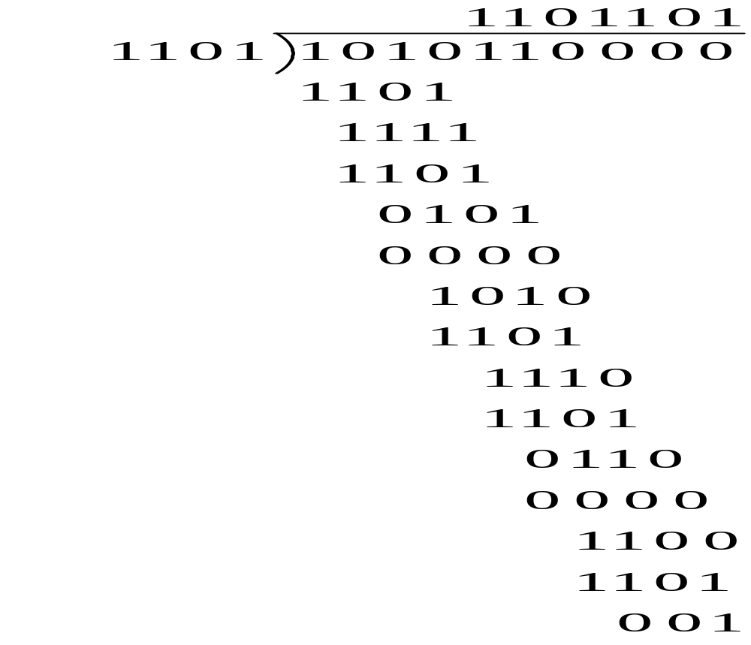
Solution
Remainder?
  001
Transmitted codeword:
  b(x) = x⁹ + x⁷ + x⁵ + x³ + 1
  b = (1,0,1,0,1,1,0,0,0,1)

Slide 27
The Pattern in Polynomial Coding
All codewords satisfy the following pattern:
b(x) = x^{n-k}i(x) + r(x) = q(x)g(x) + r(x) + r(x) = q(x)g(x)
All codewords are a multiple of g(x)
Receiver should divide received n-tuple by g(x) and check if remainder is zero
If remainder is nonzero, then received n-tuple is not a codeword

Slide 28
Exercise 1 cont’d
Q2: How does the receiver check whether the message T was transmitted without any errors? Show your work
Answer: The received message b is divided by g(x) and if the remainder is zero then b is error-free otherwise it contains errors.

Slide 29
Shift-Register Implementation
Accept information bits i_{k-1},i_{k-2},…,i₂,i₁,i₀
Append n – k zeros to information bits
Feed sequence to shift-register circuit that performs polynomial division
After n shifts, the shift register contains the remainder

Slide 30
Division Circuit
Encoder for g(x) = x³ + x + 1
0,0,0,i₀,i₁,i₂,i₃
g₀ = 1
g₁ = 1
g₃ = 1
+
Reg 0
+
Reg 1
Reg 2
Clock Input Reg 0 Reg 1 Reg 2
0 - 0 0 0
1 1 = i₃ 1 0 0
2 1 = i₂ 1 1 0
3 0 = i₁ 0 1 1
4 0 = i₀ 1 1 1
5 0 1 0 1
6 0 1 0 0
7 0 0 1 0 Check bits: r₀ = 0 r₁ = 1 r₂ = 0
r(x) = x

Slide 31
Undetectable error patterns
(Transmitter)
(Receiver)
b(x)
+
R(x)=b(x)+e(x)
(Channel)
  e(x)
Error polynomial
e(x) has 1s in error locations & 0s elsewhere
Receiver divides the received polynomial R(x) by g(x)
Blindspot: If e(x) is a multiple of g(x), that is, e(x) is a nonzero codeword, then
R(x) = b(x) + e(x) = q(x)g(x) + q’(x)g(x)
The set of undetectable error polynomials is the set of nonzero code polynomials
Choose the generator polynomial so that selected error patterns can be detected.

Slide 32
Designing good polynomial codes
Select generator polynomial so that likely error patterns are not multiples of g(x)
Detecting Single Errors
  e(x) = x^{i} for error in location i + 1
  If g(x) has more than 1 term, it cannot divide x^{i}
Detecting Double Errors
  e(x) = x^{i} + x^{j} = x^{i}(x^{j-i}+1) where j>i
  If g(x) has more than 1 term, it cannot divide x^{i}
  If g(x) is a primitive polynomial, it cannot divide x^{m}+1 for all m<2^{n-k}-1 (Need to keep codeword length less than 2^{n-k}-1)
  Primitive polynomials can be found by consulting coding theory books

Slide 33
Designing good polynomial codes
Detecting Odd Numbers of Errors
  Suppose all codeword polynomials have an even # of 1s, then all odd numbers of errors can be detected
  As well, b(x) evaluated at x = 1 is zero because b(x) has an even number of 1s
  This implies x + 1 must be a factor of all b(x)
  Pick g(x) = (x + 1) p(x) where p(x) is primitive
  Visit http://mathworld.wolfram.com/PrimitivePolynomial.html for more info on primitive polynomials

Slide 34
Standard Generator Polynomials
CRC = cyclic redundancy check
CRC-8:
CRC-16:
CCITT-16:
CCITT-32:
= x⁸ + x² + x + 1
ATM
= x¹⁶ + x¹⁵ + x² + 1
= (x + 1)(x¹⁵ + x + 1)
Bisync
= x¹⁶ + x¹² + x⁵ + 1
HDLC, XMODEM, V.41
IEEE 802, DoD, V.42
= x³² + x²⁶ + x²³ + x²² + x¹⁶ + x¹² + x¹¹ + x¹⁰ + x⁸ + x⁷ + x⁵ + x⁴ + x² + x + 1

Slide 35
Hamming Codes
Class of error-correcting codes
Can detect single and double-bit errors
Can correct single-bit errors
For each m > 2, there is a Hamming code of length n = 2^{m} – 1 with n – k = m parity check bits
Redundancy
m | n = 2^{m}–1 | k = n–m | m/n
3 | 7 | 4 | 3/7
4 | 15 | 11 | 4/15
5 | 31 | 26 | 5/31
6 | 63 | 57 | 6/63

Slide 36
m = 3 Hamming Code
Information bits are b₁, b₂, b₃, b₄
Equations for parity checks b₅, b₆, b₇
b₅ = b₁ + b₃ + b₄
b₆ = b₁ + b₂ + b₄
b₇ = + b₂ + b₃ + b₄
There are 2⁴ = 16 codewords
(0,0,0,0,0,0,0) is a codeword

Slide 37
Hamming (7,4) code
Hamming code really refers to a specific (7,4) code Hamming introduced in 1950
Hamming code adds 3 additional check bits to every 4 data bits of the message for a total of 7
Hamming's (7,4) code can correct any single-bit error, and detect all two-bit errors
Since the medium would have to be uselessly noisy for 2 out of 7 bits (about 30%) to be lost, Hamming's (7,4) is effectively lossless

Slide 38
Hamming (7,4) code
Information | Codeword | Weight
b₁ b₂ b₃ b₄ | b₁ b₂ b₃ b₄ b₅ b₆ b₇ | w(b)
0 0 0 0 | 0 0 0 0 0 0 0 | 0
0 0 0 1 | 0 0 0 1 1 1 1 | 4
0 0 1 0 | 0 0 1 0 1 0 1 | 3
0 0 1 1 | 0 0 1 1 0 1 0 | 3
0 1 0 0 | 0 1 0 0 0 1 1 | 3
0 1 0 1 | 0 1 0 1 1 0 0 | 3
0 1 1 0 | 0 1 1 0 1 1 0 | 4
0 1 1 1 | 0 1 1 1 0 0 1 | 4
1 0 0 0 | 1 0 0 0 1 1 0 | 3
1 0 0 1 | 1 0 0 1 0 0 1 | 3
1 0 1 0 | 1 0 1 0 0 1 1 | 4
1 0 1 1 | 1 0 1 1 1 0 0 | 4
1 1 0 0 | 1 1 0 0 1 0 1 | 4
1 1 0 1 | 1 1 0 1 0 1 0 | 4
1 1 1 0 | 1 1 1 0 0 0 0 | 3
1 1 1 1 | 1 1 1 1 1 1 1 | 7

Slide 39
Parity Check Equations
Rearrange parity check equations:
0 = b₅ + b₅ = b₁ + b₃ + b₄ + b₅
0 = b₆ + b₆ = b₁ + b₂ + b₄ + b₆
0 = b₇ + b₇ = + b₂ + b₃ + b₄ + b₇
In matrix form:
b₁
b₂
0 = 1 0 1 1 1 0 0 b₃
0 = 1 1 0 1 0 1 0 b₄ = H b^{t} = 0
0 = 0 1 1 1 0 0 1 b₅
b₆
b₇
All codewords must satisfy these equations
Note: each nonzero 3-tuple appears once as a column in check matrix H

Slide 40
Error Detection with Hamming Code
0
0
1
0
0
0
0
1 0 1 1 1 0 0
1 1 0 1 0 1 0
0 1 1 1 0 0 1
1
0
1
Single error detected
s = H e = =
0
1
0
0
1
0
0
1 0 1 1 1 0 0
1 1 0 1 0 1 0
0 1 1 1 0 0 1
0
1
1
1
0
0
1
1
1
s = H e = = + =
Double error detected
1
1
1
0
0
0
0
1 0 1 1 1 0 0
1 1 0 1 0 1 0
0 1 1 1 0 0 1
1
1
0
0
1
1
1
0
1
Triple error not detected
s = H e = = + + = 0

Slide 41
Hamming Distance (weight)
is the # of positions in two strings of equal length for which the corresponding elements are different (i.e., the # of substitutions required to change one into the other)
For example:
  Hamming distance between 1011101 and 1001001 is 2.
  Hamming distance between 2143896 and 2233796 is 3.
  Hamming distance between "toned" and "roses" is 3.
The Hamming weight of a string is its Hamming distance from the zero string of the same length
  it is the number of elements in the string which are not zero
  for a binary string this is just the number of 1's, so for instance the Hamming weight of 11101 is 4.

Slide 42
General Hamming Codes
For m > 2, the Hamming code is obtained through the check matrix H:
  Each nonzero m-tuple appears once as a column of H
  The resulting code corrects all single errors
For each value of m, there is a polynomial code with g(x) of degree m that is equivalent to a Hamming code and corrects all single errors
  For m = 3, g(x) = x³+x+1

Slide 43
Error-correction using Hamming Codes
(Transmitter)
b
+
R
(Receiver)
e
Error pattern
The receiver first calculates the syndrome s:
s = HR = H (b + e) = Hb + He = He
If s = 0, then the receiver accepts R as the transmitted codeword
If s is nonzero, then an error is detected
  Hamming decoder assumes a single error has occurred
  Each single-bit error pattern has a unique syndrome
  The receiver matches the syndrome to a single-bit error pattern and corrects the appropriate bit

Slide 44
Performance of Hamming Error-Correcting Code
Assume bit errors occur independent of each other and with probability p
s = H R = He
7p
s = 0
s = 0
1–3p
3p
No errors in
transmission
Undetectable
errors
Correctable
errors
Uncorrectable
errors
(1–p)⁷
7p³
7p(1–3p)
21p²

Slide 45
History of Hamming Code
Read http://en.wikipedia.org/wiki/Hamming_code

